Slide 1
Time Series: Unit 4

Slide 2
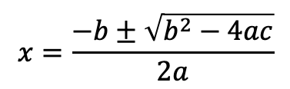
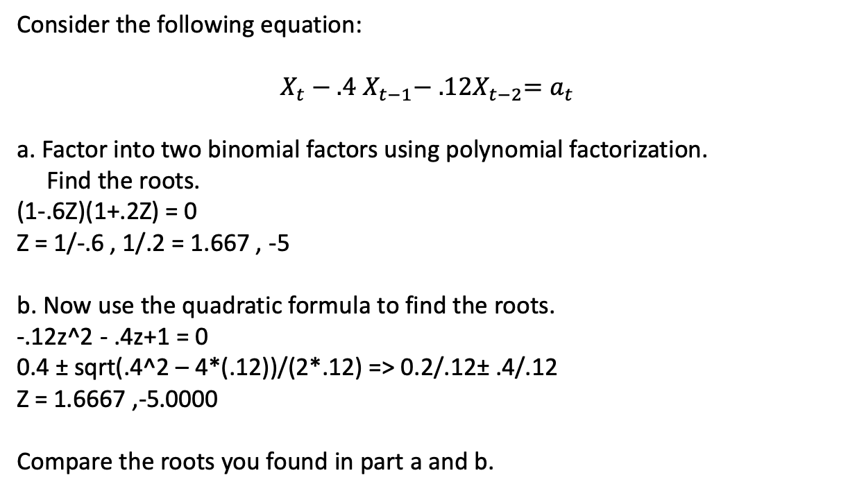
Break Out 1
Consider the following equation:
$X_{t}−.4$ $X_{t−1}−{ .12X}_{t−2}=a_{t}$
a. Factor into two binomial factors using polynomial factorization.
Find the roots.
(1-.6Z)(1+.2Z) = 0
Z = 1/-.6 , 1/.2 = 1.667 , -5
b. Now use the quadratic formula to find the roots.
-.12z^2 - .4z+1 = 0
0.4 ± sqrt(.4^2 – 4*(.12))/(2*.12) => 0.2/.12± .4/.12
Z = 1.6667 ,-5.0000
Compare the roots you found in part a and b.
$$x=\frac{−b±\sqrt{b^{2}−4ac}}{2a}$$

Slide 3
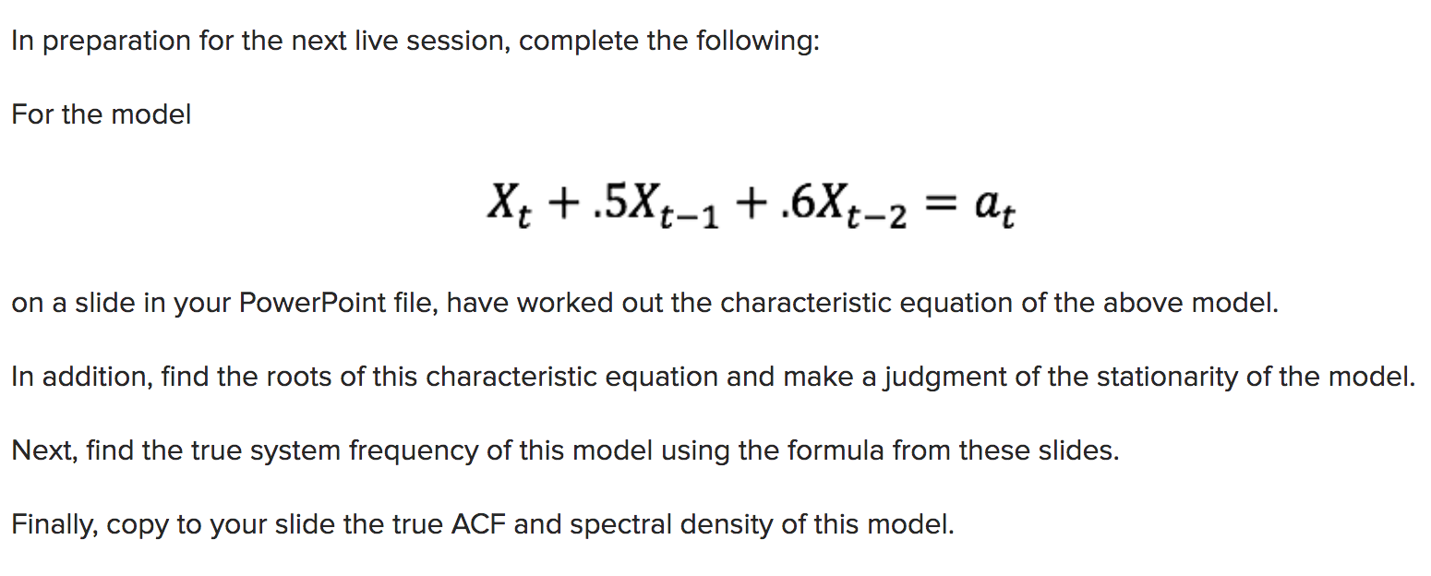
Break Out 2
Below were the instructions for the first pre live session assignment.
Please share your thoughts and / or questions on each part during this break out and we will discuss more once back in the main room!

Slide 4

Breakout 2
Here
z$=\frac{−.5±\sqrt{{.5}^{2}−4∗.6}}{2∗.6}$
-0.4167±1.2219i
Modulas
Abs z = 1/sqrt(0.4167^2 + 1.2219^2) = 0.7746
Freq = 0.3023

Slide 5
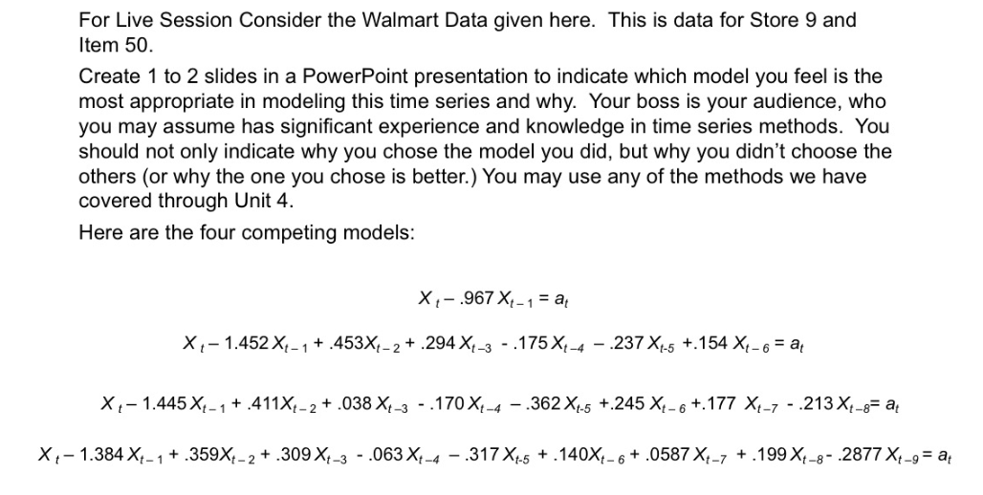
Break Out 3
Present your PowerPoint presentation to the members of your Break Out Group. Each presentation should be around 2-4 minutes. With any extra time, discuss your thoughts … keep in mind … all these models are wrong … which did you feel was most useful and why?

Slide 6
Break Out 3
Store9Item50 = Walmart %>% filter(store == 9, item == 50)
plotts.sample.wge(Store9Item50$sales)
System frequencies at approximately 0, .15, .29, .43.

Slide 7
Break Out 3
Here are three more models to investigate. Do you like any of these better? If so, are there still some shortcomings?
$${a. X}_{t}−.1516X_{t−1}−{.0769X}_{t−2}−.0016X_{t−3}+.0095X_{t−4}−.0542X_{t−5}−.1117X_{t−6}−.5683X_{t−7}=a_{t}$$
This might help:
c(0.1516, 0.0769, 0.0016, -0.0095, 0.0542, 0.1117, 0.5683)
$${b. X}_{t}−.4295X_{t−1}−{.1769X}_{t−2}−.0358−.1454X_{t−4}=a_{t}$$
$$c. X_{t}−.1529X_{t−1}−{.0988X}_{t−2}−.0059X_{t−3}+.0075X_{t−4}−.0538X_{t−5}−.1118X_{t−6}−.5717X_{t−7}−.0034X_{t−8}−.0382X_{t−9}=a_{t}$$
This might help:
c(0.1529, 0.0988, 0.0059, -0.0075, 0.0538, 0.1118, 0.5717, 0.0034, -0.0382 )
plotts.true.wge(phi = c(0.1516, 0.0769, 0.0016, -0.0095, 0.0542, 0.1117, 0.5683))
plotts.true.wge(phi = c(0.4295, 0.1769, 0.0358, 0.1454))
plotts.true.wge(phi = c(0.1529, 0.0988, 0.0059, -0.0075, 0.0538, 0.1118, 0.5717, 0.0034, -0.0382 ))

Slide 8
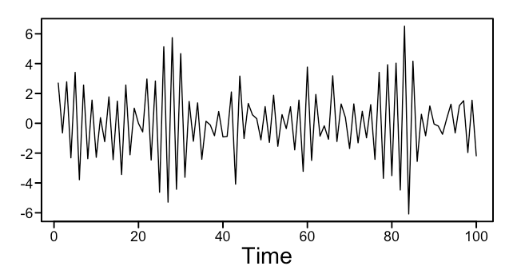
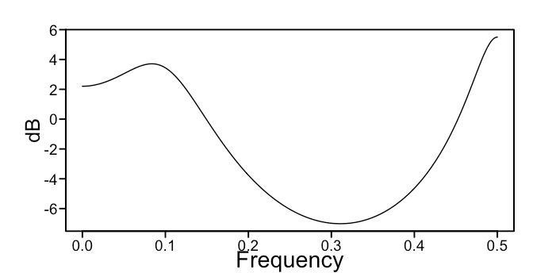
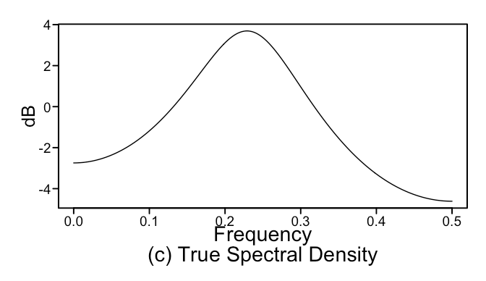
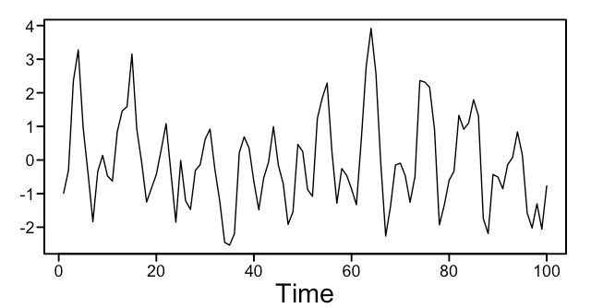



Break Out 4
Match the model on the left to the appropriate plot(s) on the right!
1.
$${a. X}_{t}−.15X_{t−1}+.4X_{t−2}=a_{t}$$
$${b. X}_{t}+.15X_{t−1}+.4X_{t−2}=a_{t}$$
2.
$${c. X}_{t}+.9X_{t−1}=a_{t}$$
3.
$${d. X}_{t}+.9X_{t−1}−{.67X}_{t−2}+.2994X_{t−3}=a_{t}$$
4.

